Slide 1
Society and Government
Alexandra Adames, Larry Dosher, Joshua Feldman, Corinne Forsberg, Emma Sampson
Period 1

Slide 2
Q: What is communism, who helped conceive of it, when was it created? What governments have followed communist ideas and what was the result?
Communism is a political theory derived from Karl Marx, advocating class war and leading to a society in which all property is publicly owned and each person works and is paid according to their abilities and needs.
Karl Marx and Friedrich Engels conceived of the idea of communism in the mid 19th century
Countries across Asia, East Europe, Africa, and South America. In the 19th century, communist philosophy began to develop in Russia (China, North Korea, Vietnam, Laos, Cuba all claimed to be communist states)
Communist philosophy argues against private property and supports collective ownership. The common view is that no person should be on their own or control any property, whether electronic, merely an idea, or otherwise

Slide 3
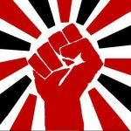
Q: What is Socialism- who helped conceived of it, and when was it created? Include governments that have followed socialist ideas - what was the result?
Socialism is an economic system where the community owns the means of production; equally owning the factors of production. People receive their shares based on how much they have worked.
Socialism as a political movement began in the industrial revolution, but the ideas of socialism began much before. The most important socialism theorist was Karl Marx, who also helped conceive communism. This is based on two main principles: to each according to his contribution; and to each according to his need, ability.

Slide 4
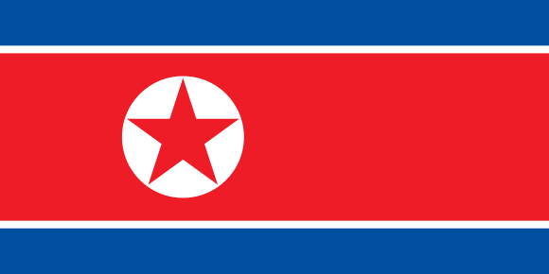
Q: What is Socialism- who helped conceived of it, and when was it created? Include governments that have followed socialist ideas - what was the result? ( Continued )
The Soviet union is one example of a socialist country, which fell in in the 90’s when Gorbachev left office; turning the Soviet union into Russia.
Today there is the example of North Korea which has turned into an extremely corrupt dictatorship

Slide 5
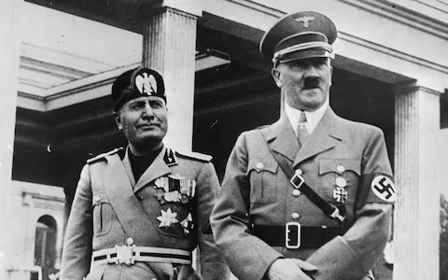
Fascism
Definition: A political philosophy, movement or regime that puts nation and race above individual
In 1919 After World War I, Benito Mussolini breaks away from the Italian Socialists and founded the Fascist Party
Mussolini conceived of Fascism in the Doctrine of Fascism in 1932

Slide 6
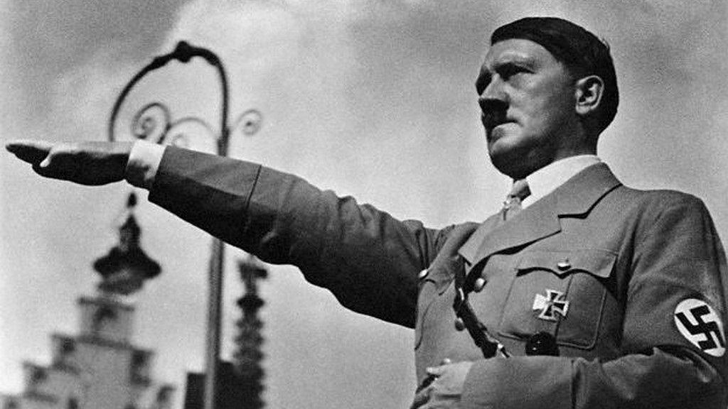
Governments that Followed Fascism
The first Fascist government was Italy, which was lead by Mussolini from 1925 - 1943
Adolf Hitler modeled Germany’s Nazi government after Italy’s government. Hitler lead Germany from 1933 - 1945
Fascist nations had extreme nationalism, news was censored about WWII and many other things, had scapegoats and used fear to manipulate citizens

Slide 7
Capitalism
Capitalism is an economic system where, instead of being controlled by the governments, the markets are controlled by private companies.
It is the current economic system of many countries, like the U.S.A., the United Kingdom, Germany, Canada, Japan, South Korea, and other countries.
The origins of capitalism are heavily debated.

Slide 8
Capitalism history
The origins of Capitalism is believed by some people to have started with societies starting to focus heavily on trading.
This would mean capitalism would have started in the 13th century
Other people think capitalism starts when charted companies and joint stocks start becoming big.
This puts the start of capitalism in the 16th and 17th centuries, and no one conceived it.

Slide 9
Who Used Capitalism?
If we decide capitalism started with the big boom of trade, then the first instance is in Italian and Netherlandic cities in the 13th century.
If we decide capitalism starts with chartered companies, then the Polo family is an early example of capitalist.
One of the most obvious examples of Capitalism in history is America during the WWI and WWII.
Then there is America during the Cold War. America lasted decades under the pressure of nuclear war and ended up outlasting the U.S.S.R.

Slide 10
Government in Fahrenheit 451
Totalitarianism- one person or group of people have complete control over an area, no individual freedom
Signs of Totalitarianism in Fahrenheit 451:
There is very little freedom in the society
The government uses firemen to burn books and information so the society will remain ignorant and more easily controlled
The government uses television screens and other media to spread propaganda

Slide 11
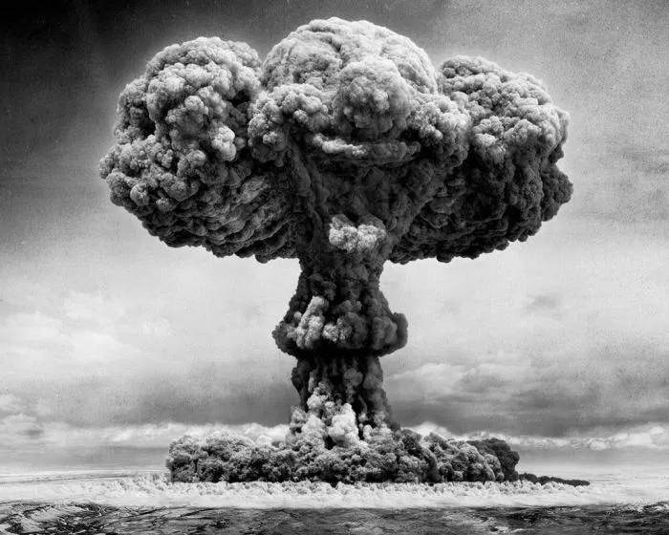
Atomic Age
Atomic Age- the nuclear age, a time period in history initiated by the first use of the atomic bomb
How it relates to the novel:
The society is constantly at war with other countries, a war was going on throughout the book
At the end of the book an atomic bomb is dropped on the city and the city is destroyed
Fahrenheit 451 was written around this time

Slide 12
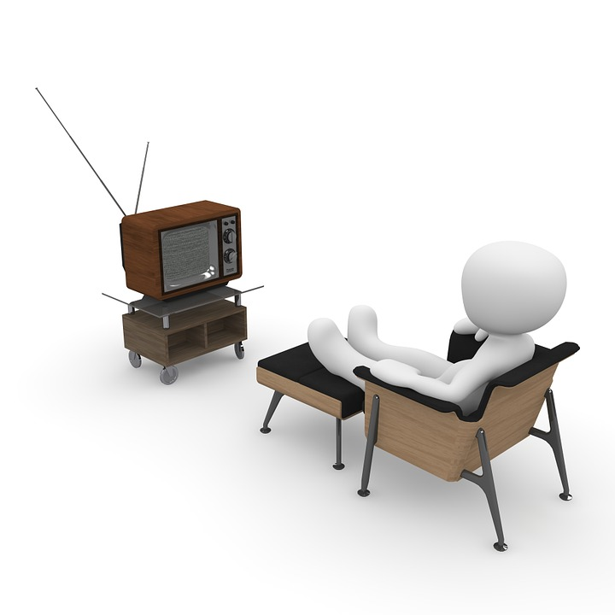
Was this topic relevant to the book?
Yes it’s relevant to the book. The obsession with technology
In Fahrenheit 451, the people are obsessed with their four giant television screen walls, their "relatives" and little earplugs they call Seashells. Much like how China is today with smartphones, tablets, 3D printers, etc. But not only china the Americas too. All most americans do is sit around and use technology
Sit another 1-2 hours while watching TV (36 percent)
Game another 1-2 hours (10 percent)
Lounge for 1-2 hours for things such as reading (25 percent)
Use their home computer for 1-2 hours (29 percent)

Slide 13
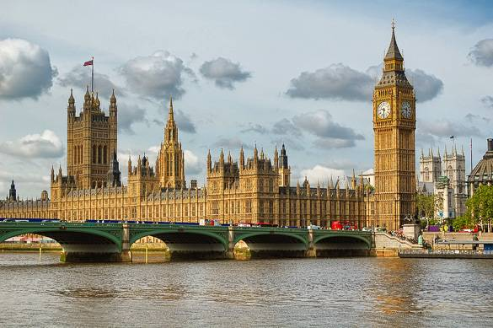
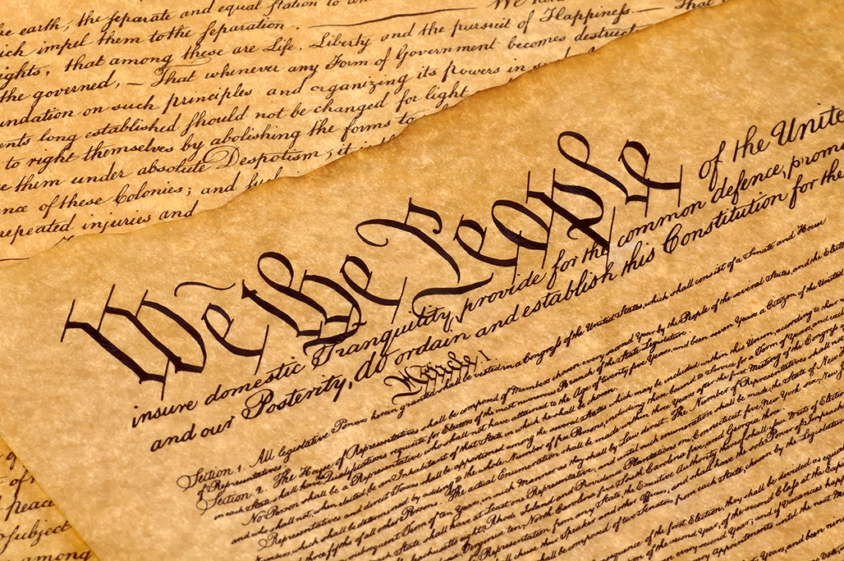
Q: How is this topic relevant today?
The topic of Society and Government is relevant today because as a citizen is important to be informed about the government and how it works. We also should know what part we the people play in the government. It is responsible to understand what the government to can do and what they cannot, so we can spot out injustice and improve things for the greater good.

Slide 14
Sources
Slide 1:
https://www.history.com/this-day-in-history/marx-publishes-manifesto
https://cs.stanford.edu/people/eroberts/cs201/projects/communism-computing-china/index.html
Slide 2:
https://www.differencebtw.com/difference-between-capitalism-and-socialism/
https://www.britannica.com/topic/socialism
https://www.investopedia.com/terms/s/socialism.asp

Slide 15
Sources
Slide 3: https://www.merriam-webster.com/dictionary/fascism
https://www.history.com/this-day-in-history/mussolini-founds-the-fascist-party
https://ratical.org/ratville/CAH/fasci14chars.html
Slide 4: https://www.merriam-webster.com/dictionary/capitalism http://www.historyworld.net/wrldhis/PlainTextHistories.asp?historyid=aa49

Slide 16
Sources
Slide 5:
https://www.britannica.com/topic/totalitarianism
Slide 6:
http://www.dictionary.com/browse/atomic-age
Slide 7: https://www.prnewswire.com/news-releases/new-survey-to-sit-or-stand-almost-70-of-full-time-american-workers-hate-sitting-but-they-do-it-all-day-every-day-215804771.html
Slide 8: https://statesymbolsusa.org/symbol-official-item/national-us/state-cultural-heritage/united-states-constitution
https://www.gov.uk/government/how-government-works

